Slide 1
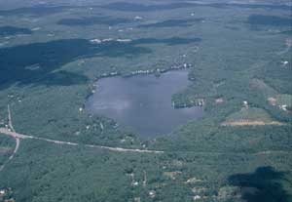
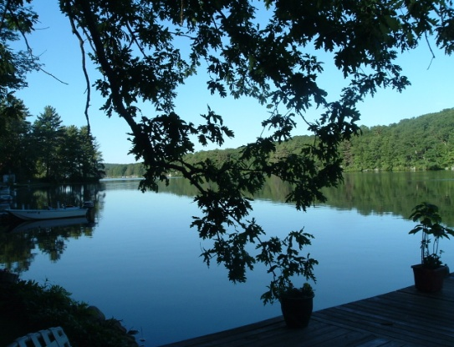
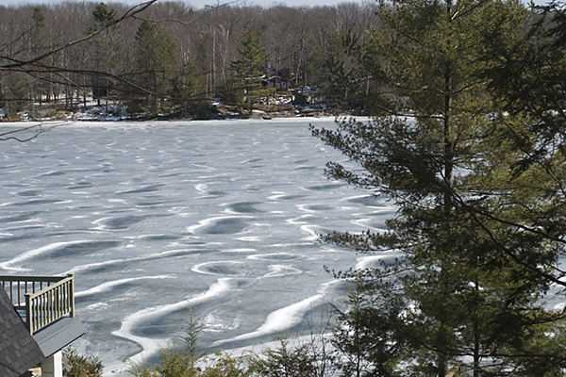
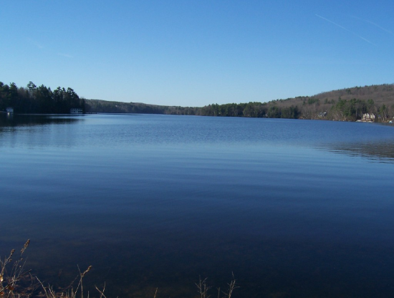
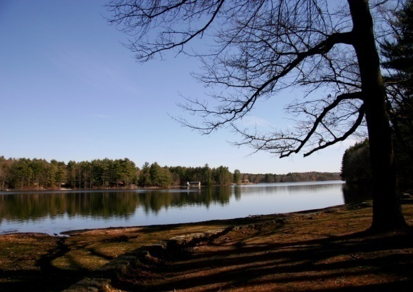
S.L.A.C. Report to Selectmen
October 12, 2010

Slide 2
Agenda
Introductions
Background
SLAC Progress
Conclusion

Slide 3
SLAC Representatives
Town of Sturbridge Selectmen – Teddy Goodwin;
Sturbridge Conservation Commission - Donna Grehl;
Big Alum Lake Association – Joel Casaubon, Tammy Chase (Secretary), Bruce Gran;
Cedar Lake Association – Greg Abrams, Fran O’Connell;
Leadmine Pond Association – Laurel/Steve Carpenter. Bill Kenyon (former), Laurie Palmer;
Quaboag-Quacumquasit Lake Association (QQLA) – Chris Mazeika, Marita Tasse, David Mitchell; and
Walker Pond Association – Greg Hale, John O’Brien Jr. (Chairman)
United States Army Corps of Engineers (USACE) - Tom Chamberland (for East Brimfield Reservoir / Long Pond);

Slide 4
S.L.A.C. Background
Established December 2007 by Sturbridge Board of Selectmen
  SPECIAL THANKS TO TEDDY GOODWIN
Informational Meeting 3/08-7/08
  MORE SPECIAL THANKS TO DAVID MITCHELL
  01/09 presented recommendations to Town at Selectmen Meeting
06/08/09 Passage of warrant article to recognize SLAC
  EVEN MORE THANKS TO SELECTMEN FOR SUPPORTING RECOMMENDATIONS
SLAC representatives appointed in spring 2009 and have been meeting to identify and recommend action items

Slide 5
Goals of the SLAC
Wise use and enjoyment of our Lakes
Lakes effect on Community
  Community Education
  Create and enhance public awareness of the lakes
Environmentally-sound stewardship of these common resources
Report findings and recommendations to Board of Selectman
The mission of the Sturbridge Lake Advisory Committee is to establish wise stewardship and an effective management mechanism for the sustainable use of the Town’s water resources and protection of their watersheds. Lake management should be developed through consensus from a collaborative, community wide pool of stakeholders that shall include lake users, lake associations, civic groups, and municipal government.

Slide 6
Why we’re here tonight
Report Back on Progress of SLAC
Selectman’s feedback
Where we’d like to go:
  Development of Website
  Sponsorship of Boating Safety Course
  Develop Boat Inspection

Slide 7
Initial Activities
1st Order of Business: Develop Sub-Committees to address common concerns
Prioritization of Issues
  Water Quality
  Invasive Aquatic Species
  Boating Regulations
  Overcrowding
  Parking/Boat Ramps
  Watershed Development
Formation of Sub Committees
  Boating Regulations
  Aquatic Plant Management
  Water Quality
  Community Outreach
  Communications
  Funding
  Legislative
Original 8 sub-committees have been combined down to 4
Boating Regulations, Aquatic Resources, Community Outreach, Legislative

Slide 8
Continuing Activities for SLAC
Management best practices from diverse sources: State, Internet, literature, other lake associations, etc.
  We communicate with each other
  Recent presentation on organization and funding by Dick Cazeault, WLA president
  Review of EPA permitting requirements for weed treatment
  QQLA Pilot Program
SLAC meetings held on last Wednesday of the month
  Reports from each of the Sub-Committees
  Look to recruit additional volunteers to work on the high priority issues;
  Don’t need to be in a lake association to join!
For additional information contact:
  John O’Brien (SLAC Chairman) at: jeojr68@gmail.com
  Selectman Teddy Goodwin at: edwardpgoodwin@gmail.com

Slide 9
Priority Issues
Boating Regulations
  Address concerns of Boating Regulations and Overcrowding
  Local Police support
Community Outreach
  How do we get the message of SLAC out to Community
    Community Outreach
    Communications
    Funding
Aquatic Resources
  Address Concerns of Water Quality and Invasive Species
    Aquatic Plant Management
    Water Quality

Slide 10
Boating Regulations
State Mandates
Informing Visitors
Lake Specific Recommendations
Boaters Safety Course
Boating Rule | MGL | Big Alum | Cedar | Leadmine | South | Walker
All water skiers, jet skiers & tubers must wear Coast Guard Approved life preserver |  | X | X | X | SM | SM
NO water skiing, jet skiing or tubing after sunset. No vessel shall operate faster than headway speed between sunset & sunrise |  | X | X | X | SM | SM
Boats towing water skiers or tubers MUST have an observer or spotter on board. |  | X | X | X | SM | SM
All boats must show proper lighting after sundown. NO exceptions |  | X | X | X | SM | SM
Skin divers and snorkelers must have a visible tube with a flag attached |  | X |  | X | SM | SM
Mufflers on boats may NOT be modified in a manner that will increase the noise level of the vehicle | 332 CMR, Pg.624.118 | X | X | X | SM | SM

Slide 11
Community Outreach
SLAC Message
  Lake Associations
  Town of Sturbridge
  Informational Clearinghouse
Goals
SLAC Website
  .ma-us .org ???
Logo
Tag Line
Develop/Distribute Print Material
TRHS Environmental Sciences Project
S.L.A.C. concerns beyond the lakes themselves, but their affect and connection to the water supply for the Town

Slide 12
Aquatic Resources
SLAC volunteers coordinate with the Sturbridge Conservation Commission to conduct an annual Great Pond Monitoring
Annual summer sampling has been conducted from 2002-2010 and data used for diagnostic assessment of the ponds
SLAC Water Quality Sub-committee to develop Sturbridge Pond Water Quality Database and Quality Assurance Project Plan (QAPP) for pond monitoring

Slide 13
Measures of significance of the Great Ponds of Sturbridge*
Contains 1247 acres of lake area
Vital natural resources for fish, waterfowl and aquatic habitats in Quinebaug River Valley
Recreational hotspots for fishing, boating, etc
Location of 304 waterfront parcels (one out of six homes in Sturbridge); with waterfront property worth of > $70 million
Interest and commitment of over 650 lake association members in five organizations.
* Data taken from the SLAC Final Report, 2009.

Slide 14
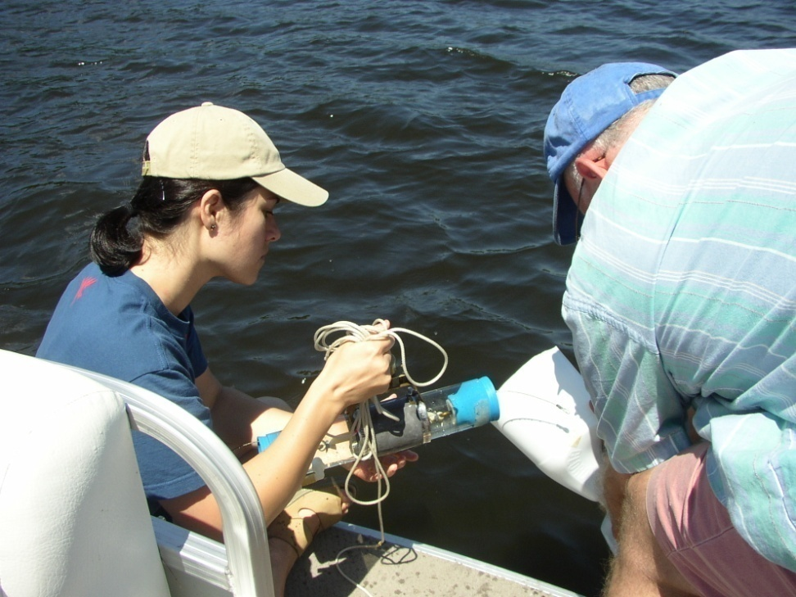
Reasons for Great Pond Monitoring
Provides baseline data to compare with future data to detect trends
Forms basis for conducting informed lake management
Allows evaluation of efficiency of various treatments
Economic incentives for protection of shoreline property values (tax basis)

Slide 15
Aquatic Resources
Some ponds impacted by invasive aquatic weeds
Need to prevent spread of invasive species to other ponds
  Boat inspections/cleanings
  Surveys of lake bottom area near boat ramps
  Boater education
Innovative plant control techniques being studied in South Pond

Slide 16
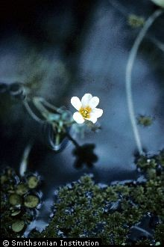
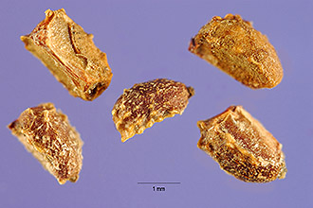
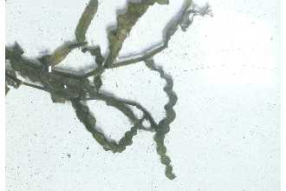
Non-indigenous invasive species:
Cabomba caroliniana (South Pond)
Myriophyllum spicatum (South Pond)
Potomogeton crispus
(Big Alum Pond, Cedar Lake)

Slide 17
SLAC Needs for Success
Continued support from Town Agencies
Coordination with State Agencies
Program Specific Volunteers
Funding
  Creation of Website
  Print Materials
  Material Distribution
  Boat Inspection
  Boater Safety Course

Slide 18
THANK YOU!!!
To My Fellow SLACers for all of you efforts
To the Current and Past members of the Board of Selectmen for your recognition of this Committee and your continued support
To the Lake Associations
Judy Knowles and Lorraine Murawski for putting up with my endless questions
Residents of Sturbridge
QUESTIONS???

